Slide 1
ASIC FLOW AND IO FILES

Slide 2
TOPICS OF INTEREST
ASIC FLOW
EDA VENDORS AND THEIR TOOLS
IO FILES REQUIRED

Slide 3
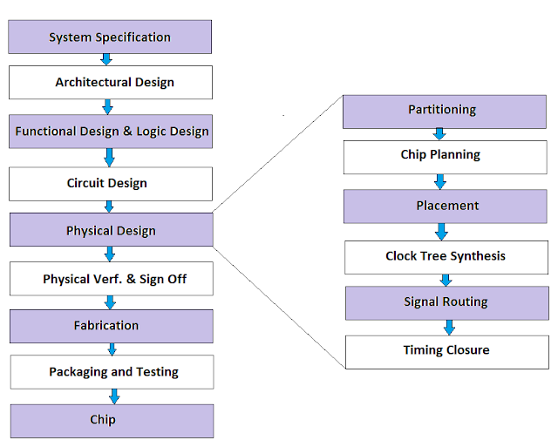
ASIC FLOW

Slide 4
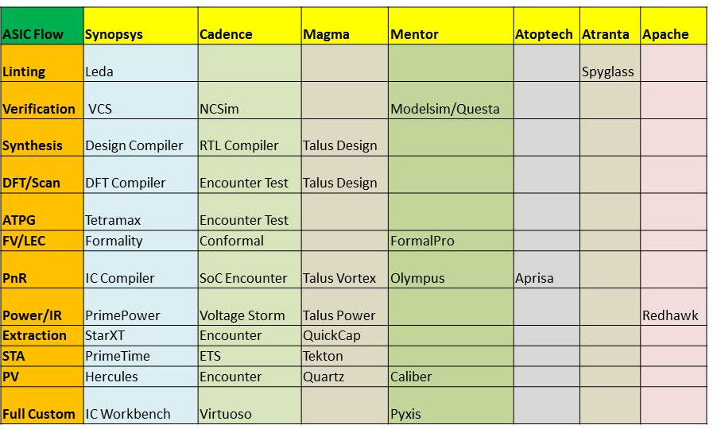
EDA Tool Vendors

Slide 5
INPUT FILES
Gate level netlist:
This is the synthesized netlist.
The synthesis team performs synthesis on RTL code with the standard cell libraries and constraints and converts the RTL code into the gate-level netlist based on available standard cells.
This file contains all the instances of design and their connection.
File name – xyz.v

Slide 6
Constraint file:
A Constraint file is popularly known as an SDC file by its extension of the file. It contains basically,
Units (Time, Capacitance, Resistance, Voltage, Current, Power)
System interface (Driving cell, load)
Design rule constraints (max fanout, max transition)
Timing constraints (Clock definitions, clock latency, clock uncertainty, input/output delay)
Timing exceptions (Multi-cycle and false paths)

Slide 7
LOGICAL LIBRARY
The logical library is also called a timing library or functional library or power library as it contains the functionality, time and power information of cells.
This file contains basically the following information of the standard cells or macros.
Timing details of the standard cells / macros ( delay, transitions)
Setup and hold time of standard cells / macros
Functionality details of standard cells /macros
Area of standard cells / macros
Pin directions and capacitance
Leakage power of standard cells / macros
The logical libraries could be either in liberty format .lib file for Cadence tool or in the form of .db file for Synopsys tool.
Liberty file is created by doing the standard cell library characterization, so this file is provided by the standard cell library vendor.

Slide 8
Physical libraries:
The physical library contains the abstract view of the layout for standard cells and macros.
LEF file basically contains:
Size of the cell (Height and width)
Symmetry of cell
Pins name, direction, use, shape, layer
Pins location
Physical libraries are in Library Exchange Format (.lef) for the Cadence tools or .CELL and .FRAM form for Synopsys tool.
This file is provided by the standard cell library vendor.

Slide 9
Technology file:
The technology library is the most critical input to the physical design tool. The technology library contains detailed information about all the metal layers, vias and their design rules. This file is in ASCII format and basically contains the following information:
Manufacturing grid
Layers name (poly | contact | metal1 |via2 )
Types and the direction of the metal
Pitch
Width
Spacing
Resistance (per square unit)
The technology file used by the Cadence tool is .techlef format and .tf format by Synopsys tool.

Slide 10
RC coefficient file:
TLU file is a short form of “Table Look-Up” used for RC estimation and extraction or we use QRC file or cap table for the same.
RC extraction in VLSI is a parasitic extraction method that calculates the resistance (R) and capacitance (C) of wires, which are a factor in net delay.
TLU+ files contain the following information:
A table of wire caps at different net lengths and spacing
RC coefficient for a specific technology
R, C parasitics of metal per unit length
Net delay details in the form of combined resistance and capacitance
MMMC view file:
Multi-Mode Multi-Corner file is used to generate different analysis views based on different delay corners and constraints modes.
Delay corners are defined on library sets and RC corners. There are various library set files based on voltage and temperature values (like ss, ff, typical).

Slide 11
Block partition:
For block-level PnR, we need a defined core area for the block or block partitions which defines the size and shape of the block.
Block shape could be a simple rectangular or a complex rectilinear shape.
Pin def:
For block-level PnR, pin locations have been decided by the Full chip owner and for block-level, we have to use the pre-decided pin location in order to match the pin locations with other blocks.
Generally, it is given in form of a def file.
In case of any pin placement issue at the block level, the block owner can inform the person who is placing the pin and if required block owner can also edit the pin placement.

Slide 12
Power intent (UPF | CPF file):
The power intent file describes which power rails should be routed to individual blocks and when the block should be powered on or shut down.
Unified Power Format (.upf) and Common Power Format (.cpf) are two different formats of power intent files.
CPF format is used by the Cadence tool and UPF format by the other tools.
We must need this file if the block is having a multi-voltage domain.
Switching activity files (VCD | SAIF):
SAIF or VCD file is used basically for the dynamic IR analysis in the Physical design.
Dynamic IR analysis provides the Dynamic power drop inside the chip based on the switching activities.

Slide 13
OUTPUT FILES
REPORTS (TIMING, AREA, POWER, CONGESTION, SUMMARY, DESIGN..)
QOR
LOG FILES
DEF FILE
GDS FILE

Slide 14
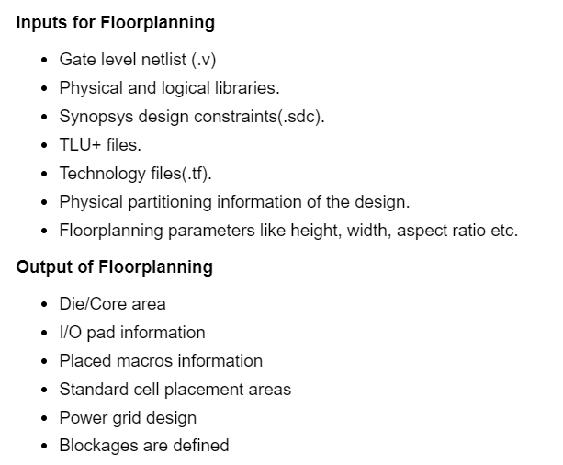
IO FILES AT FLOORPLAN

Slide 15
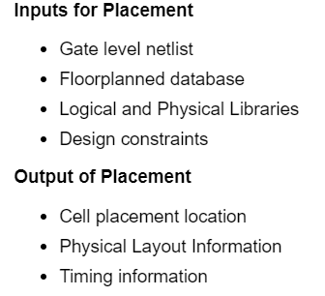
AT PLACEMENT

Slide 16
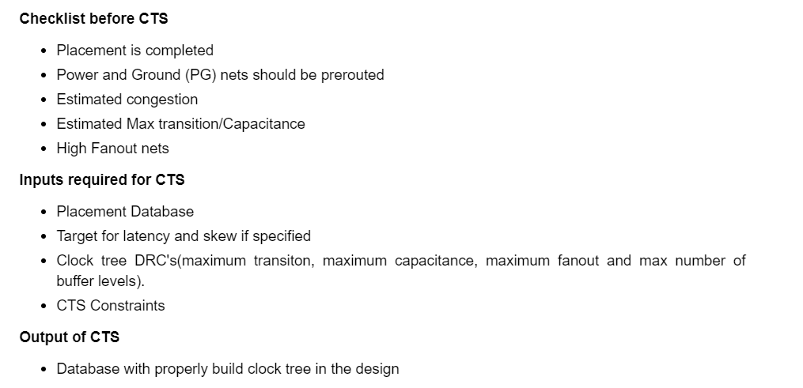
AT CTS

Slide 17
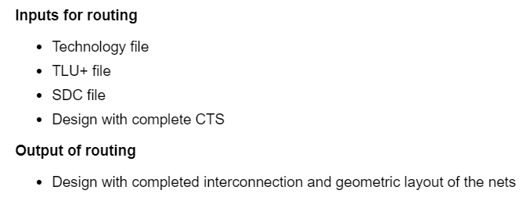
AT ROUTING

Slide 18
AT STA
Inputs for STA:
Design Netlist
SDC
LIB
SPEF
Optional inputs:
Instance-based IR drop file
SI library
Base/Incr Delay annotation file
Outputs of STA:
Timing reports
ECO file

Slide 19
AT PHYSICAL VERIFICATION
Inputs:
I. DRC
Merged GDS file
DRC RuleDeck file
II. Antenna
Merged GDS file
DRC RuleDeck file
III. Layout Vs Schematic Check (LVS)
PD Netlist
Merged GDS file
IV. Logic Equivelence Check (LEC)
Golden Netlist
PD Netlist
LEC Constraints (if any)

Slide 20
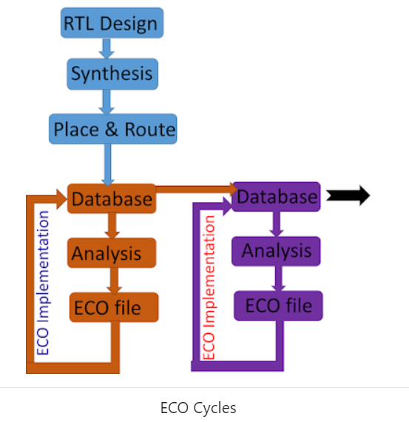
ECO – ENGINEERING CHANGE OF ORDER
ECO Phase:
ECO phase is the phase of design where we close all the signoff checks which remain open in the PnR stage.
Generally in PnR we make timing, DRC and IR closable but the final closing is done in ECO phase.
In ECO phase, we close the PnR implementation activities and solve all the open issue through the ECO only.
In ECO phase we focus on closing each open issue, we generate ECO file and implement them on PnR tool incrementally.

Slide 21
LINKS FOR PD CONTENT
1. https://www.vlsi4freshers.com
2. https://teamvlsi.com/contents
3. https://www.youtube.com/@VLSIAcademyhub/videos
PATH TO FIND ALL THE BASIC INPUT OUTPUT FILES
/nas/nas_v1/Innovus_trials/users/amulya/paths_for_training

